Slide 1
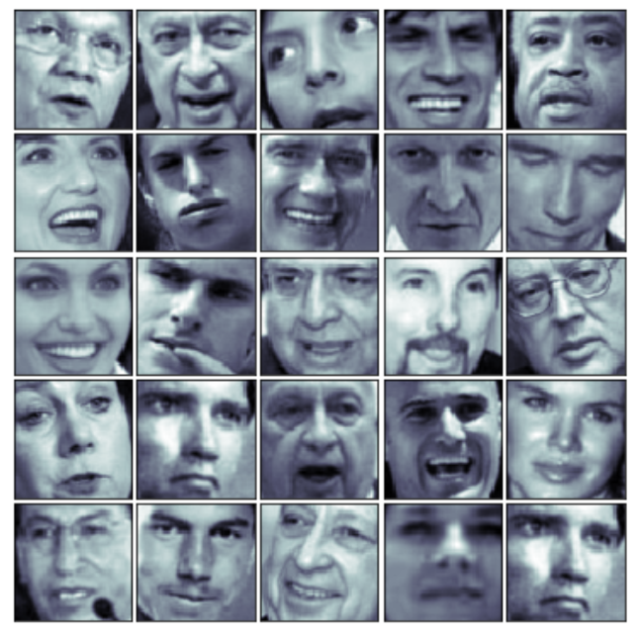
PCA
Image Compression and Reconstruction using PCA
Guided by: Dr. Mahmoud Parsian
Kalyani Rane
Lasya Pathuri

Slide 2
PROJECT IDEA
The main idea of our project is to reduce the dimensionality of a dataset consisting of many dimensions.
We will be working on images to compress them into a smaller size by reducing the number of dimensions in them.
Every pixel in an image is a dimension (feature/variable).
As we result a 64X64 image will have 4096 dimensions.
After compressing the images, we reconstruct them from the compressed images.

Slide 3

PCA is an Unsupervised dimensionality reduction technique.
Helps to identify correlations and patterns
We zero out 1 or more of the smallest Principal Components (PC) resulting in lower dimensional projection of data.
PCA preserves maximum data variance.
Creates a new subset of features that are representative of the original features.
What is PCA?

Slide 4

PCA
WHY DO WE NEED PCA???

Slide 5
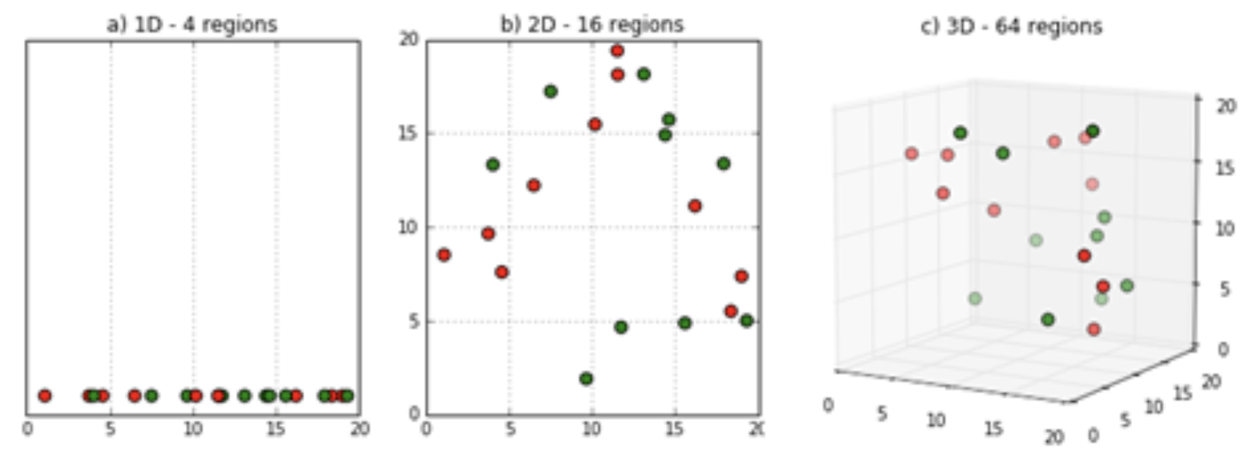
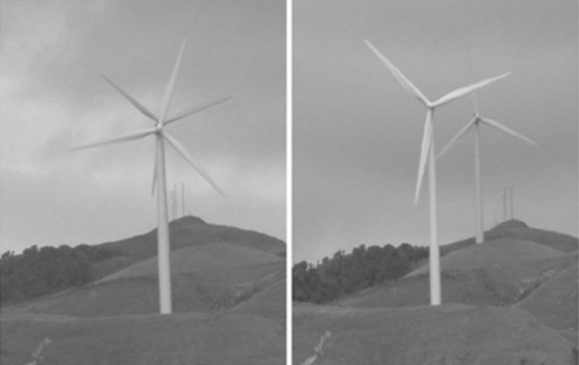
CURSE OF DIMENSIONALITY
Sparsity of data occurs when moving to higher dimensions.
In order to obtain a statistically sound and reliable result, the amount of data needed to support the result often grows exponentially with the dimensionality.
The second issue that arises is related to sorting or classifying the data. In low dimensional spaces, data may seem very similar but the higher the dimension the further these data points may seem to be.

Slide 6
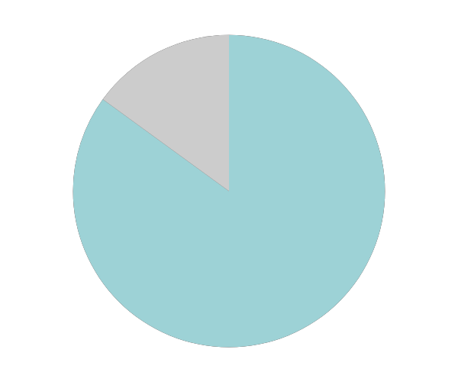
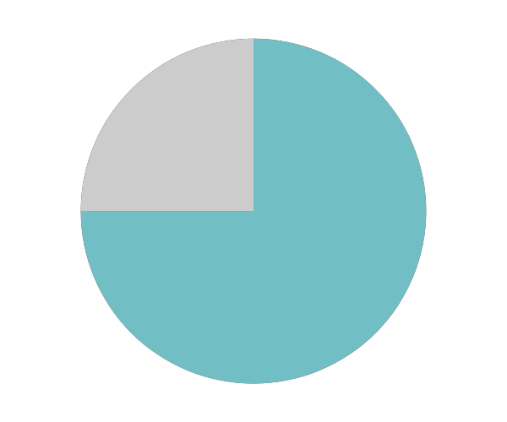
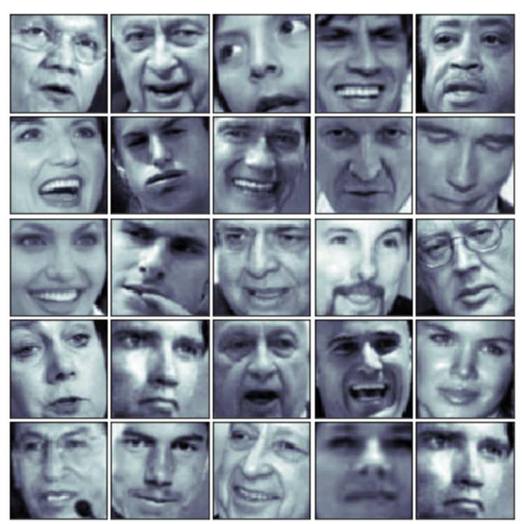


TYPE
Facial Images
NUMBER OF IMAGES
Dataset used for PCA
1000 Unique Images
SHAPE OF DATA
64X64
FORMAT
PGM

Slide 7
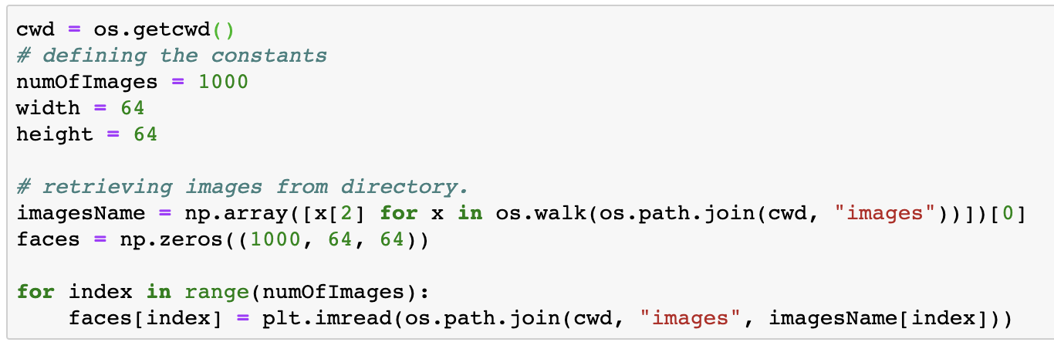
LOADING THE DATA
OS module in Python provides functions for interacting with the operating system. OS comes under Python’s standard utility modules. os.getcwd()-method tells us the location of the current working directory (CWD).
Retrieved images from the directory and stored as an numpy array of shape (1000,64,64)

Slide 8
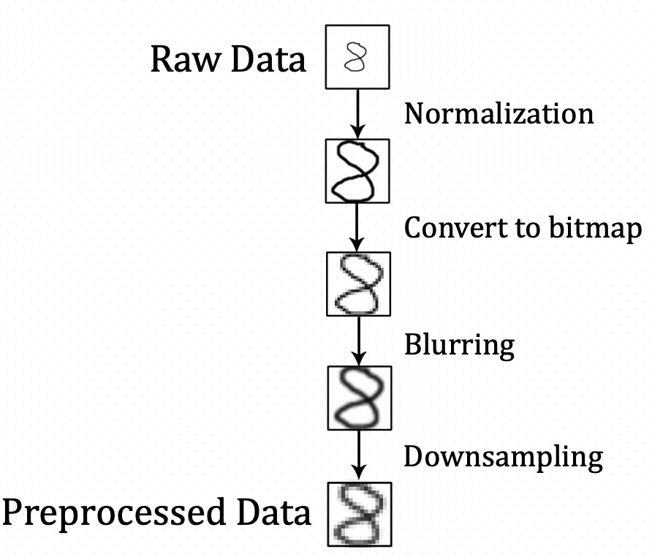
PCA
PRE-PROCESSING FOR PCA

Slide 9
GENERIC PCA PRE-PROCESSING
Rescaling the features to have Mean of 0.
STANDARDIZATION
Adjusting values measured on different scales to a notionally common scale.
NORMALIZATION
Convert all String data to Numerical data.
STANDARDIZATION
Rescaling the features to have Standard Deviation of 1.
CONVERSION
Standard Scalar function from SKLearn can be used to perform standardization of data. Z- Score normalization can be used to normalize data.

Slide 10
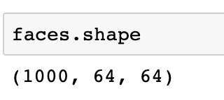
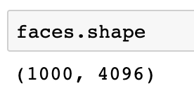
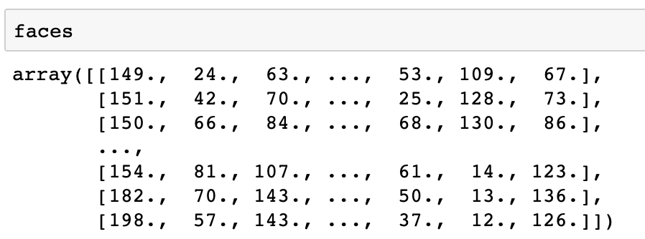
PRE-PROCESSING OF IMAGES
Load the image dataset into a numpy array of size (1000, 64, 64).
Reshape the data into a 2D numpy array of size (1000, 4096) ==> 64*64 = 4096
Use ‘StandardScaler()’ from SKLearn to standardize the dataset.

Slide 11
STEPS TO PERFORM PCA
STANDARDIZATION
COVARIANCE
EIGEN-VALUES
EIGEN-VECTORS
PRINCIPAL COMPONENTS
DIMENSION
REDUCTION

Slide 12
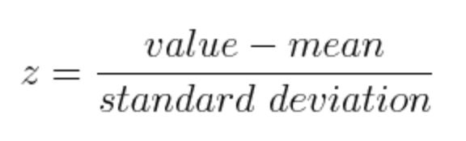
STANDARDIZATION & NORMALIZATION
The aim of this step is to standardize the range of the continuous initial variables so that each one of them contributes equally to the analysis.
That is, if there are large differences between the ranges of initial variables, those variables with larger ranges will dominate over those with small ranges leading to biased results.

Slide 13
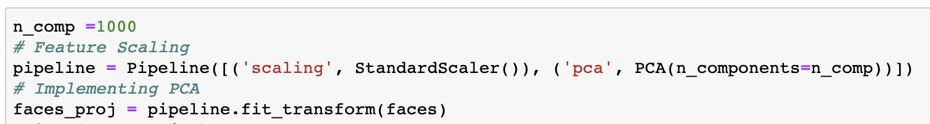
FEATURE SCALING AND IMPLEMENTING PCA
Pipeline: Sequentially applies a list of transforms and a final estimator.
Here we used StandardScaler, which standardizes the data for us.
Next step in Pipeline is to implement PCA and fit_transform it to our data.

Slide 14
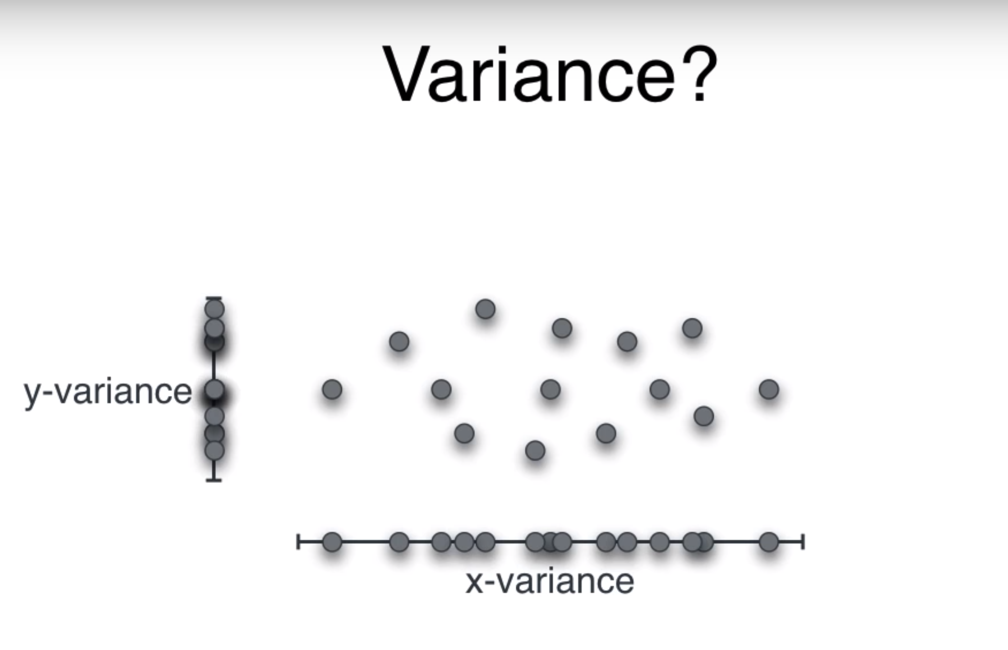
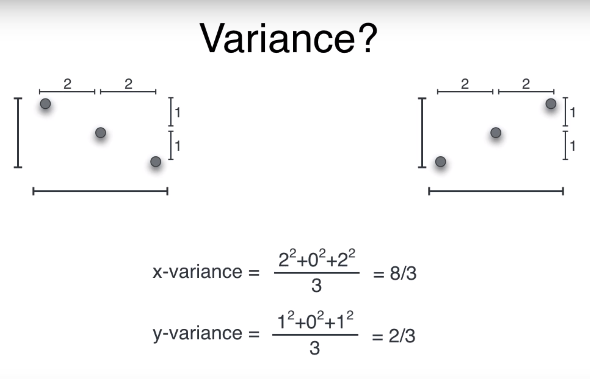
LET’S UNDERSTAND VARIANCE
Informally, it measures how far a set of (random) numbers are spread out from their average value.

Slide 15
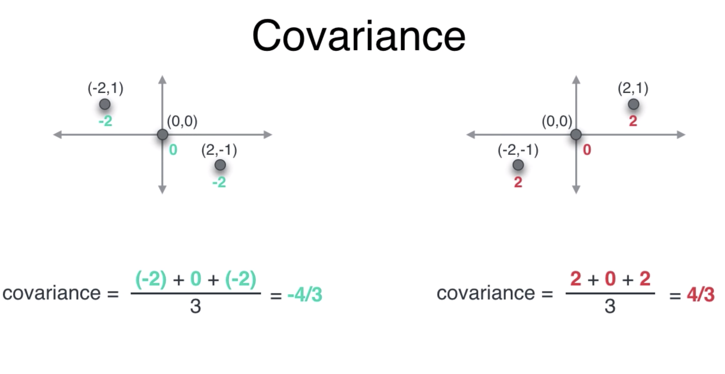
LET’S UNDERSTAND COVARIANCE
Covariance is a measure of the joint variability of two random variables.

Slide 16
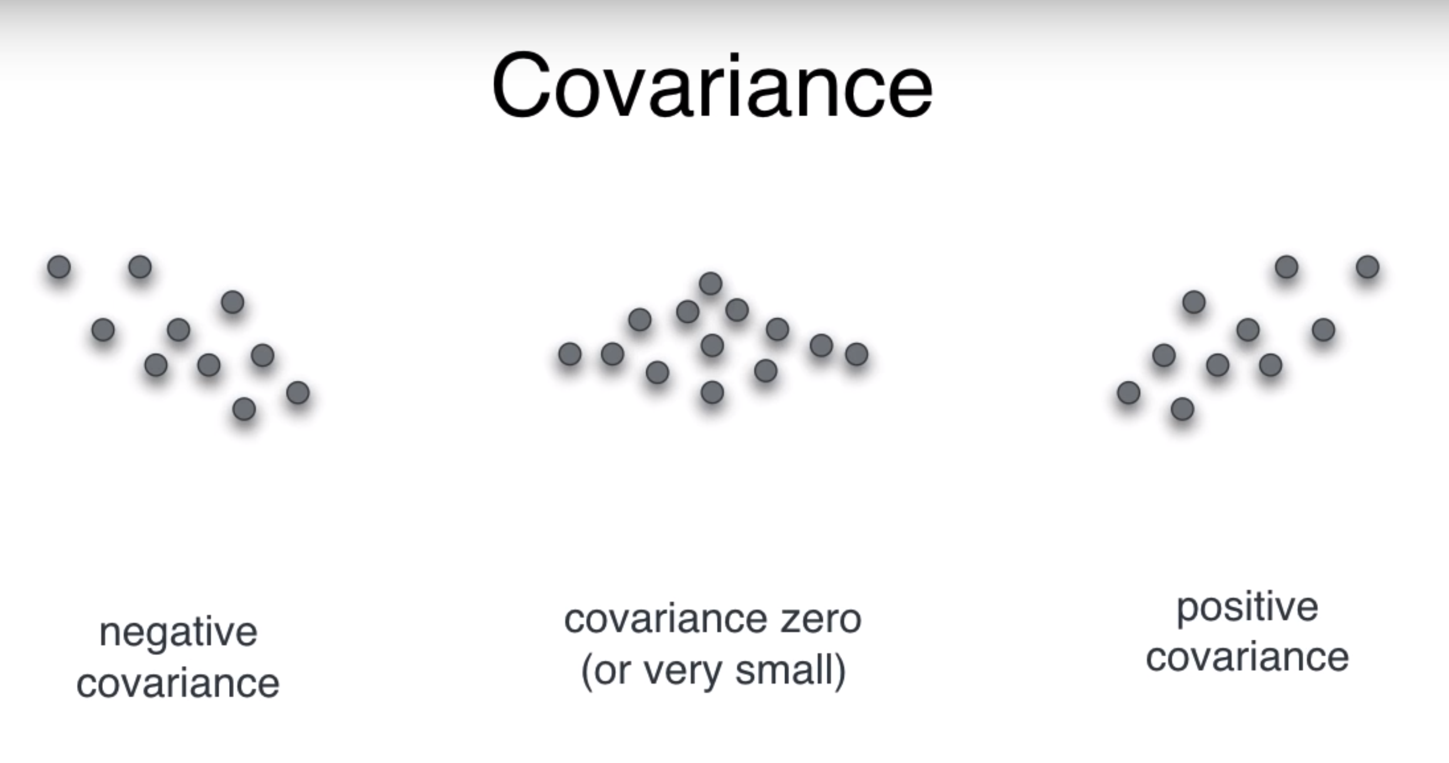
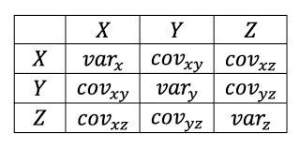
COVARIANCE MATRIX
Covariance matrix represents the correlation between variables in dataset.
It is a pXp matrix where p is dimensions of our data.
It is commutative therefore, a to b is same as b to a. As a results, matrix is always symmetric.
Value shows how co-dependent the variables are.

Slide 17
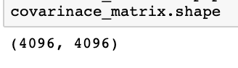
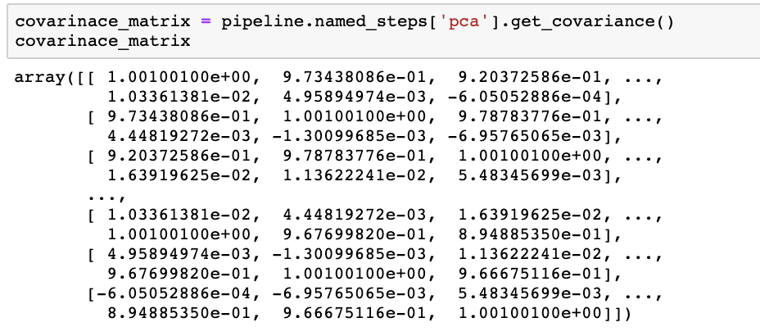
COVARIANCE MATRIX FOR OUR DATASET

Slide 18
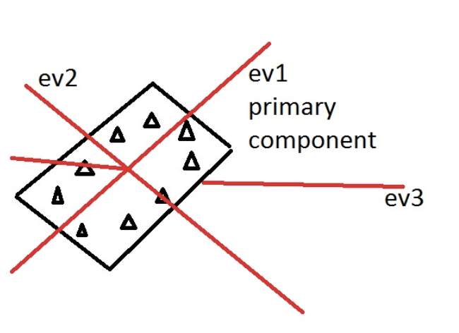
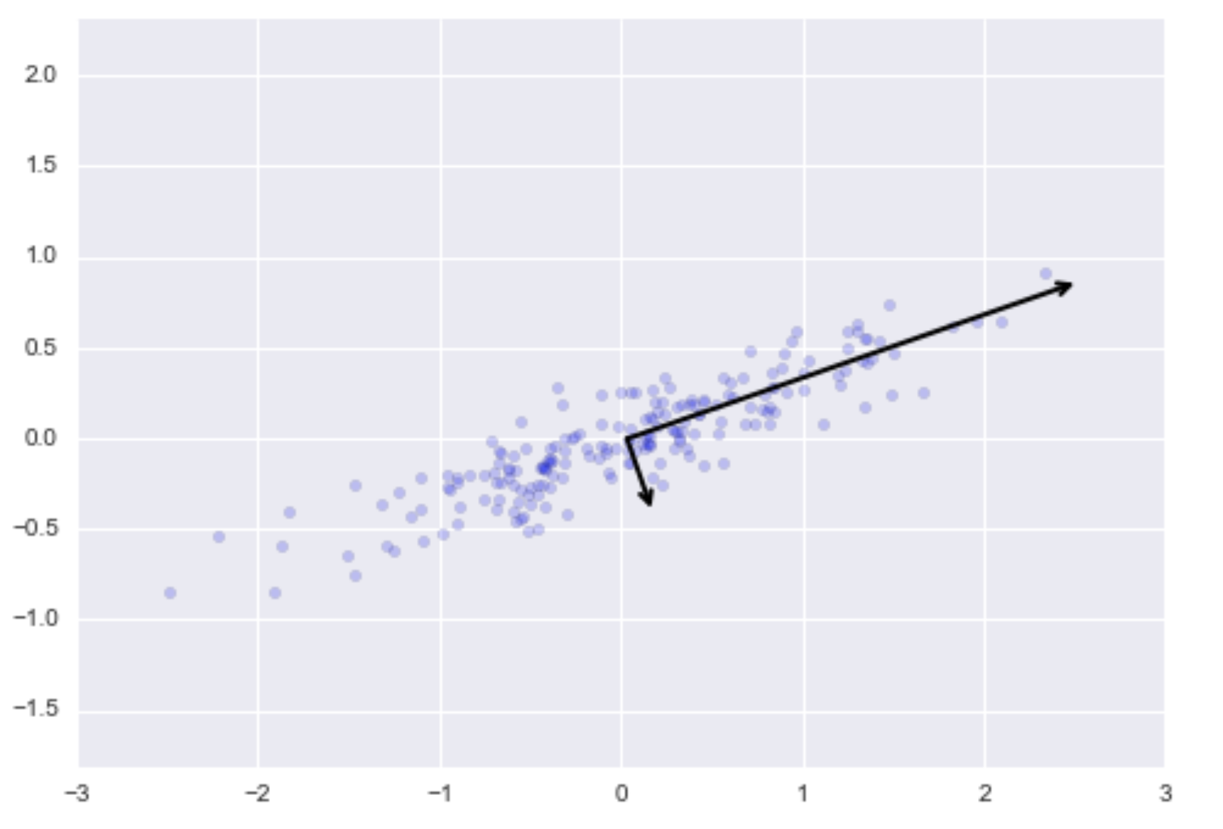
EIGEN VECTORS AND EIGEN VALUES
They are a new set of variables obtained from initial variables.
New variables are highly significant and independent of each other.
Eigenvectors and values are essential in determining the number of PCs.
Eigen vectors give the direction and eigenvalues are scalars which give magnitude.

Slide 19
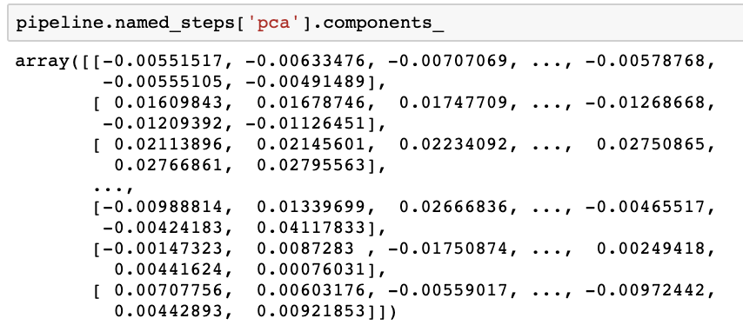
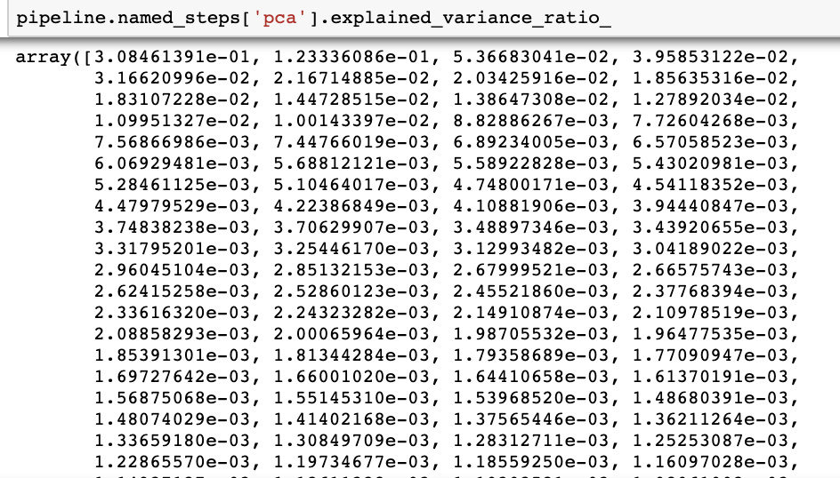
EIGEN VECTORS AND EIGEN VALUES FOR OUR DATASET
EIGEN VECTORS EIGEN VALUES

Slide 20
EIGEN FACES
Eigenfaces can be considered a set of "standardized face ingredients, derived from statistical analysis of many pictures of faces.
Any human face can be considered to be a combination of these standard faces. For example, one's face might be composed of the average face plus 10% from eigenface 1.55% from eigenface 2, and even −3% from eigenface
It does not take many eigenfaces combined together to achieve a fair approximation of most faces.

Slide 21
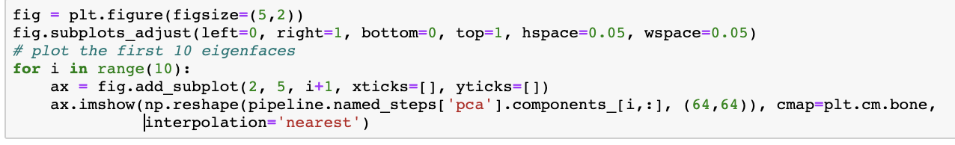
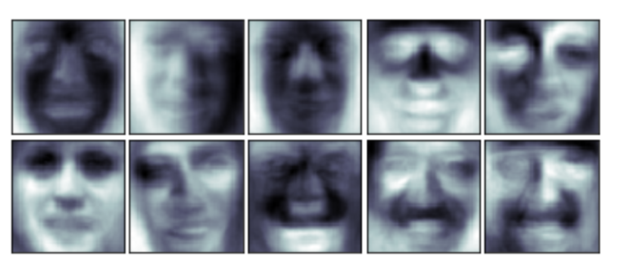
PLOTTING EIGEN FACES

Slide 22
PRINCIPAL COMPONENTS
Principal components are new variables that are constructed as linear combinations or mixtures of the initial variables.
PCA tries to put maximum possible information in the first component, then maximum remaining information in the second and so on.

Slide 23

PRINCIPAL COMPONENTS
The first PC goes through the origin and in which the projection of the points (red dots) is the most spread out.
The second principal component is calculated in the same way, with the condition that it is uncorrelated with (i.e., perpendicular to) the first principal component
This continues until a total of PCs is equal to the number of original number of variables.

Slide 24
PRINCIPAL COMPONENTS
PC1 - Spans the direction of the most variation
PC2 - Spans the direction of 2nd most variation
PC3 - Spans the direction of 3nd most variation
So on…
If we have data with 4096 dimensions (64*64):
PC4096 Spans the direction of 4096th most variation

Slide 25
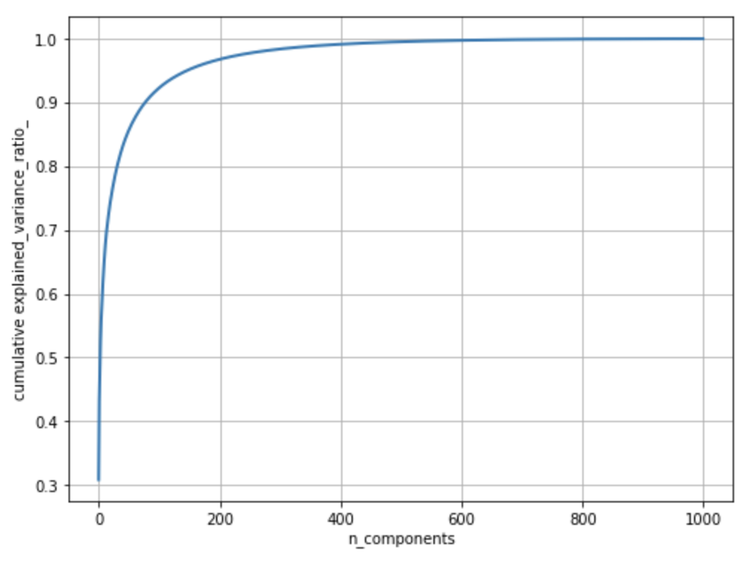
Choose smallest value of K such that maximum variance is obtained.
Typically we want 95-99% variance retained in our data.
Plot a graph - Number of components vs Cumulative variance.
How to choose the number of PCs?

Slide 26
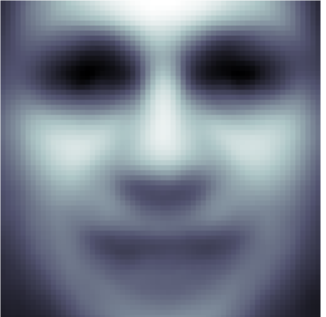
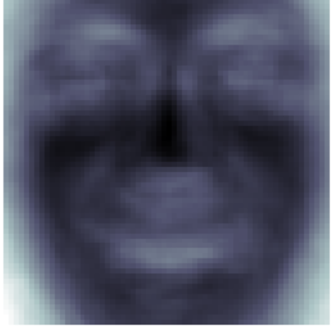
COMPUTING MEAN AND SD
Mean Face
Standard Deviation Face

Slide 27
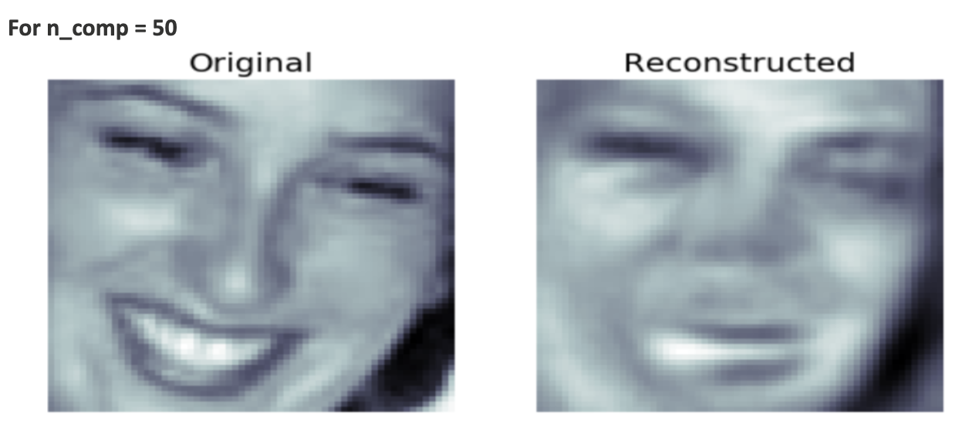
RECONSTRUCTION OF IMAGES
Used inverse_transform () to get the images back. It transforms data back to its original space.
Change the number of components (n_comp) and repeat the process.

Slide 28
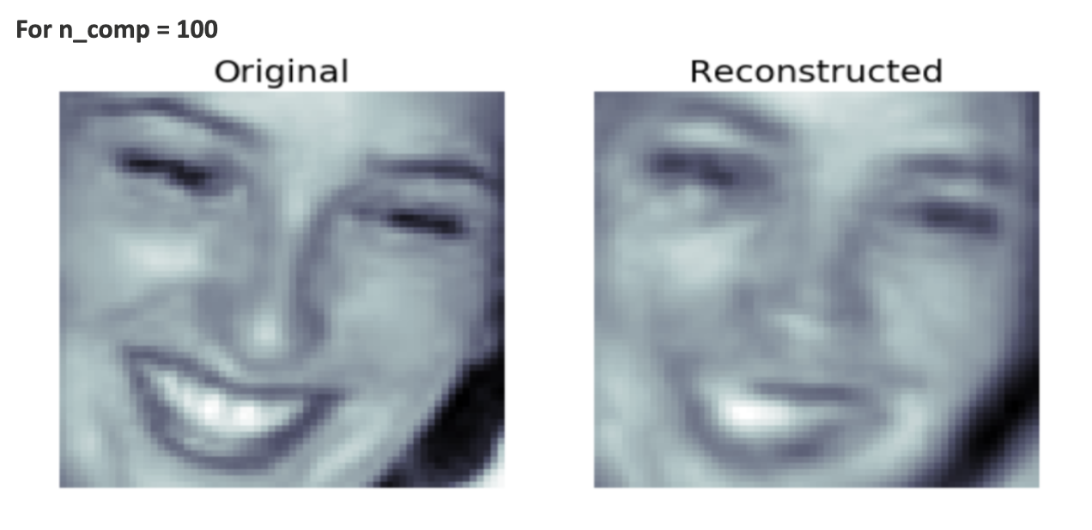
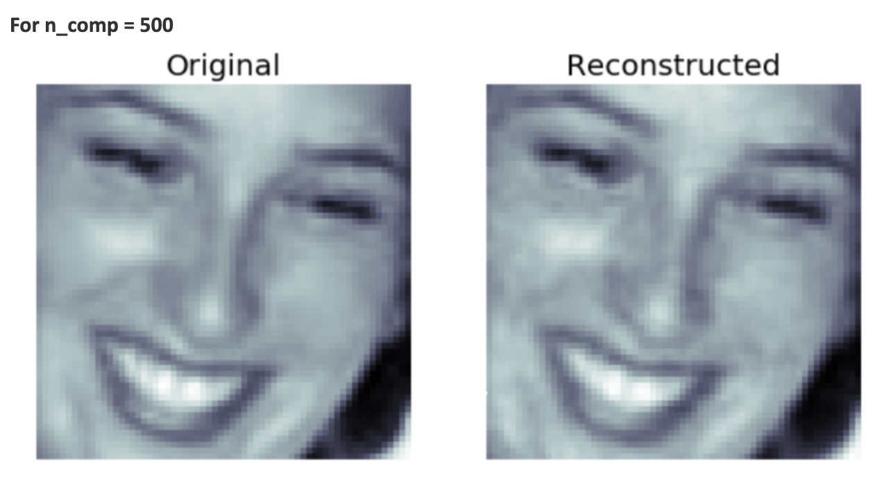
RECONSTRUCTION OF IMAGES

Slide 29
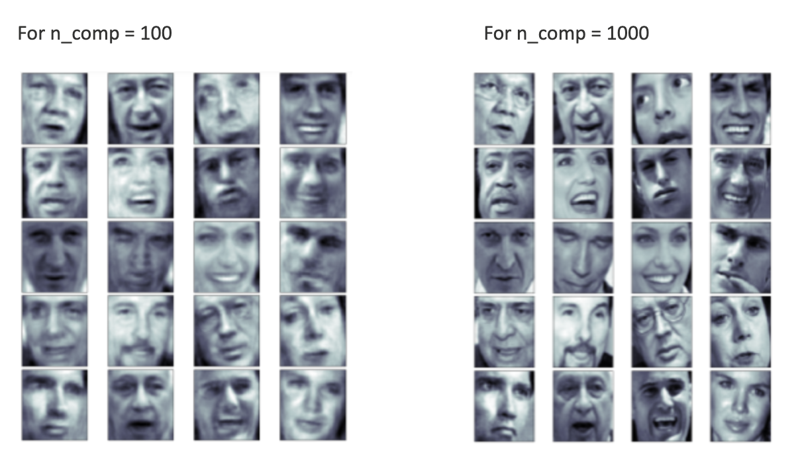
RECONSTRUCTION OF IMAGES

Slide 30
PCA WITHOUT SCIKIT
Calculating mean of the images matrix
imagesMean = (faces.mean(axis=1)).reshape(-1,1)
Instead of using pipeline, we have normalized the data as
normalisedImages = faces - imagesMean
Calculated covariance matrix as a product of normalized data and its transpose
covarianceMatrix = (normalisedImages).dot(normalisedImages.T)
Computed eigenvalues and eigenvectors using linalg.eig
eigenValues, eigenVectors = np.linalg.eig(covarianceMatrix)
Sorted the eigenvalues in descending order

Slide 31
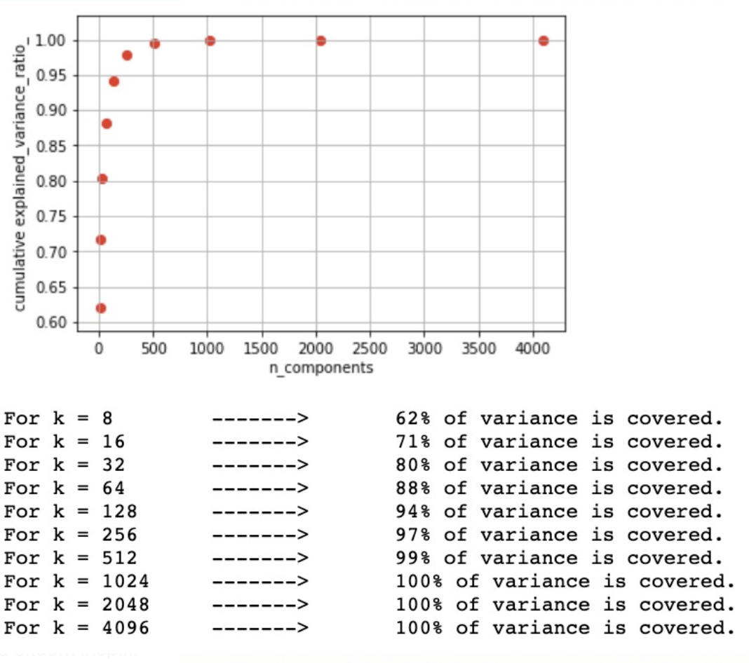
From the adjacent figure, we can see how the variance increases with increase in number of PCs.
After a certain point, 100% variance is achieved and further increasing the number of PC is no longer useful.
Number of PC’s Vs Variance (without SCIKIT)

Slide 32
CONCLUSION
As we increase the Number of Principal Components,
Image reconstruction Quality increases
File Size is Drastically Reduced
512 components instead of 4096 can explain 99% of the Variance!!

Slide 33
LIMITATIONS OF PCA
PCA generates principal components, which are linear combinations of the original features.
PCA does not necessarily help segmenting or separating data.

Slide 34
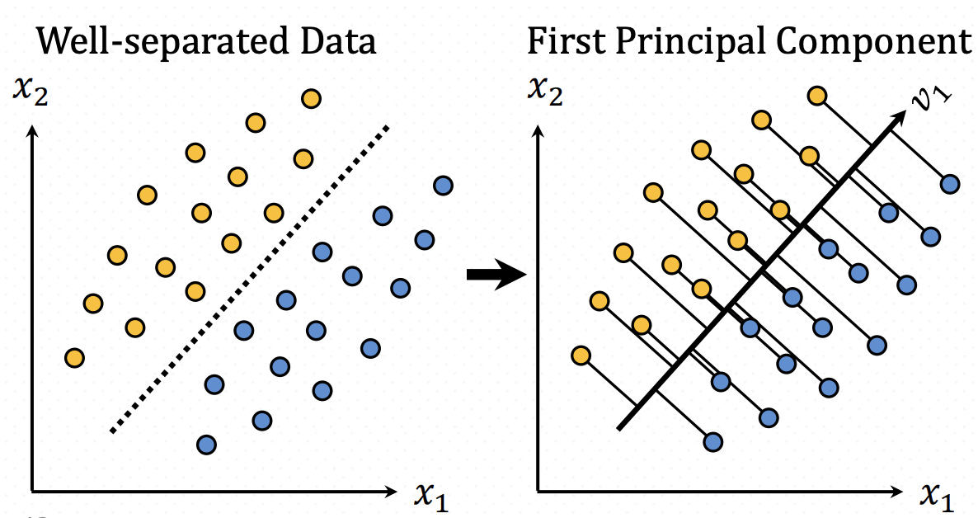
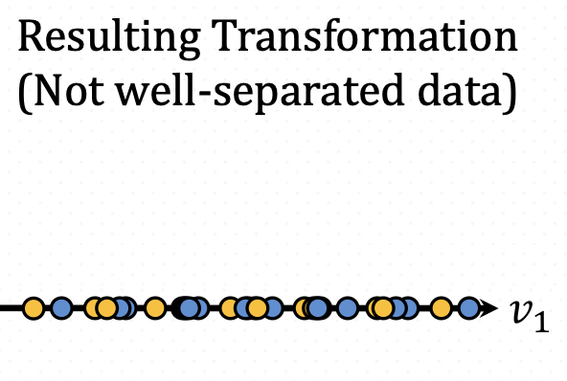
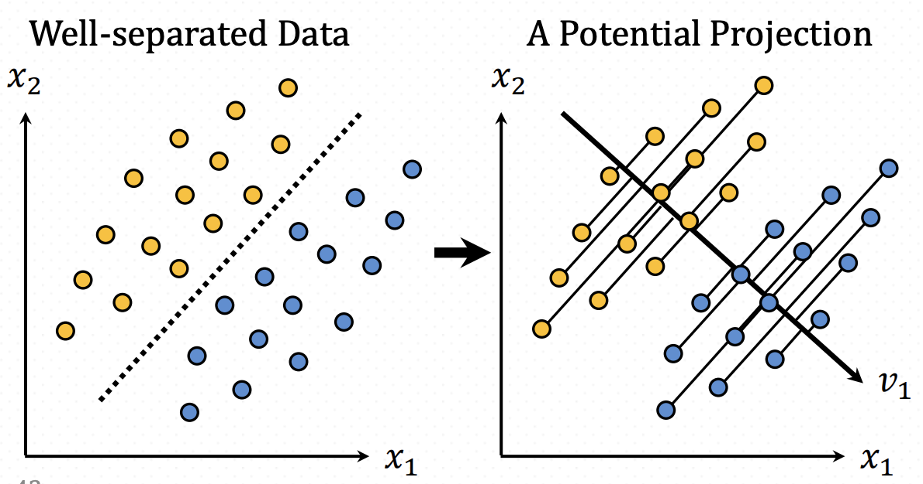
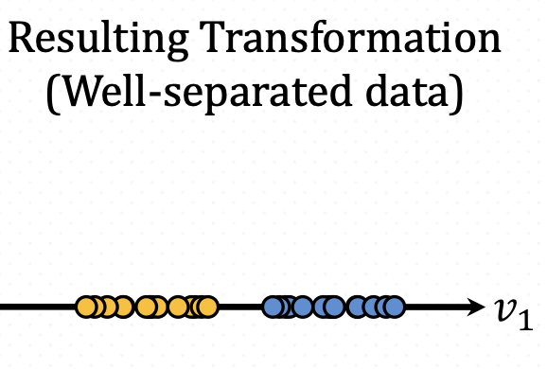
LIMITATIONS OF PCA - Separating Data
PCA does not necessarily help segmenting or separating data, and thus does not necessarily improve modeling.
Better projection

Slide 35
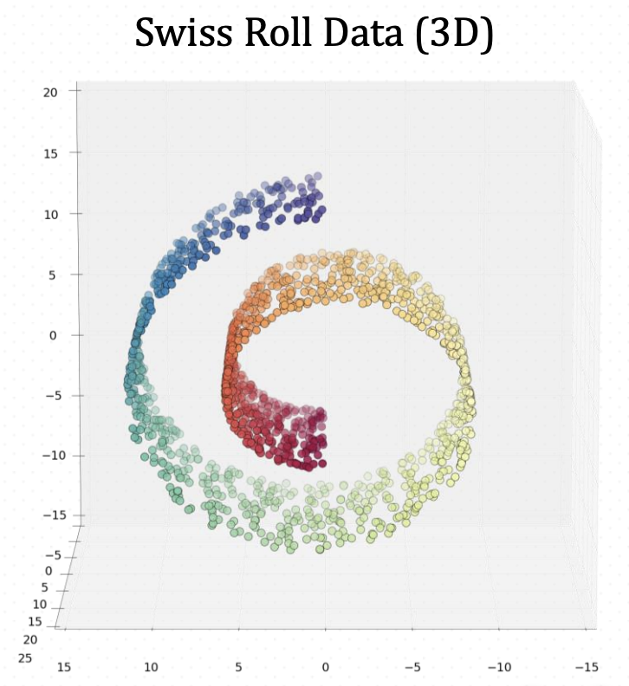
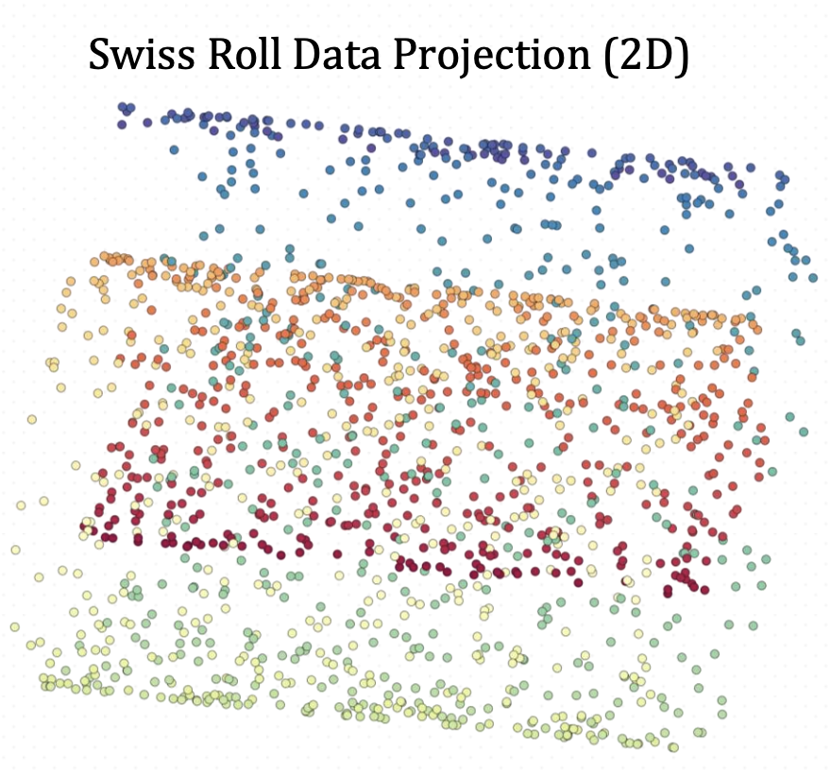
LIMITATIONS OF PCA - Non Linear Data
Notice that as a result of PCA, the projected data is not well-separated.
The principal components maximize the variance, but not necessarily the separation of the data.

Slide 36
THANK YOU

